Slide 1
Probability and Statistical Inference
Comparing More Than Two Groups
Comparing non-numerical variables
Sources used in creation of this lecture:
Statistics and Data Analysis, Peck, Olsen and Devore; Discovering Statistics Using IBM SPSS, Andy Field; Understanding Basic Statistics, Brase and Brase;SPSS Survival Manual, Julie Pallant

Slide 2


Comparison of more than 2 samples
Tell me the difference between these groups…
Thank God I have ANOVA
Notes:
In an experiment with more than 2 samples or more than 2 tasks (or 2 samples and 2 tasks), one could do lots of t-tests and compare all the different groups with each other this way but actually you increase the possibility of falsely rejecting the null-hypothesis tremendously (this is referred to as familywise/ experimentwise error rate). It is much better to use ANOVA.

Slide 3

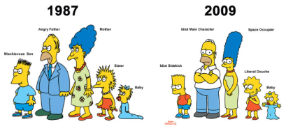

Tests for Multiple Group Comparison
 | Independent Samples | Related Samples
Interval measures/ parametric | ANOVA* | Repeated** Measures ANOVA
Ordinal/ non-parametric | Kruskall-Wallis | Freidman
* multiple different groups of participants
** multiple same participants measured at multiple different points
Notes:
There are lots of different types of t-tests, which need to be used depending on the type of data you have
(equal) interval measures
Scales in which the difference between consecutive measuring points on the scale is of equal value throughout
No arbitrary zero, ie positive and negative measures, eg temperature
Ordinal measures
Scales on which the items can be ranked in order
There is an order of magnitude but intervals may vary, ie one item on the scale is more or less than another but it is not clear by how much as this cannot be measured
Often statements/ feelings are attached to numbers which can then be used for rating; in fact, this data can only be ranked (from highest to lowest) , ie what score had the highest turn-out
1= very good, 2= good, 3= neutral, 4= bad, 5= very bad
Different measurements have a direct influence on the way analysis is conducted because some of them are more amenable to mathematical operations than others

Slide 4
ANOVA
ANalysis Of VAriance (ANOVA)
Still compares the differences in means between groups but it uses the variance of data to “decide” if means are different
Really is ANOVASMD (Analysis of variance to see if means are different)
Looks to see what the variation (variance) is within the groups, then works out how that variation would translate into variation (i.e. differences) between the groups, taking into account how many subjects there are in the groups.
If the observed differences are a lot bigger than what you'd expect by chance, you have statistical significance.
Notes:
ANOVA tests for one overall effect only (this makes it an omnibus test), so it can tell us if experimental manipulation was generally successful but it doesn’t provide specific information about which specific groups were affected. ⇨need for post-hoc testing!
ANOVA produces F-statistic or F-ratio which is similar to t-score as it compares the amount of systematic variance in the data to the amount of unsystematic variance. As such, it is the ratio of the experimental effect to the individual differences in performance. If the F=ratio’s value is less than 1, it must represent a non-significant event (so you always want a F-ratio greater than 1, indicating that experimental manipulation had some effect above and beyond the effect of individual differences in performance). To test for significance, compare obtained F-ratio against maximum value one would expect to get by chance alone in an F-distribution with the same degrees of freedom. p-value associated with F is probability that differences between groups could occur by chance if null-hypothesis is correct.

Slide 5
ANOVA
Factors: the overall ‘things’ being compared (e.g. age, task, score)
Levels: the elements of the factor (young v old and naming v reading aloud)
F- statistic or F-ratio
Magnitude of the difference between the different conditions
Similar to z or t-score as it compares the amount of systematic variance in the data to the amount of unsystematic variance.
It is the ratio of the experimental effect to the individual differences in performance.
Less than 1, it must represent a non-significant event (so you always want a F-ratio greater than 1)
Degrees of freedom – depends on the number of factors and the number of levels
Notes:
ANOVA tests for one overall effect only (this makes it an omnibus test), so it can tell us if experimental manipulation was generally successful but it doesn’t provide specific information about which specific groups were affected. ⇨need for post-hoc testing!
ANOVA produces F-statistic or F-ratio which is similar to t-score as it compares the amount of systematic variance in the data to the amount of unsystematic variance. As such, it is the ratio of the experimental effect to the individual differences in performance. If the F=ratio’s value is less than 1, it must represent a non-significant event (so you always want a F-ratio greater than 1, indicating that experimental manipulation had some effect above and beyond the effect of individual differences in performance). To test for significance, compare obtained F-ratio against maximum value one would expect to get by chance alone in an F-distribution with the same degrees of freedom.

Slide 6
ANOVA
ANOVA tests for one overall effect only
Omnibus test
There is a need for post-hoc testing
ANOVA can tell you if there is an effect but not where
Need to perform multiple comparisons to identify level of effect and where effect is evident
To test for significance
obtained F-ratio is compared against maximum value one would expect to get by chance alone in an F-distribution with the same degrees of freedom.
p-value associated with F is probability that differences between groups could occur by chance if null-hypothesis is correct
Reporting convention: F= 65.58, df= 4,45, p< .001
Notes:
ANOVA tests for one overall effect only (this makes it an omnibus test), so it can tell us if experimental manipulation was generally successful but it doesn’t provide specific information about which specific groups were affected. ⇨need for post-hoc testing!
ANOVA produces F-statistic or F-ratio which is similar to t-score as it compares the amount of systematic variance in the data to the amount of unsystematic variance. As such, it is the ratio of the experimental effect to the individual differences in performance. If the F=ratio’s value is less than 1, it must represent a non-significant event (so you always want a F-ratio greater than 1, indicating that experimental manipulation had some effect above and beyond the effect of individual differences in performance). To test for significance, compare obtained F-ratio against maximum value one would expect to get by chance alone in an F-distribution with the same degrees of freedom.

Slide 7
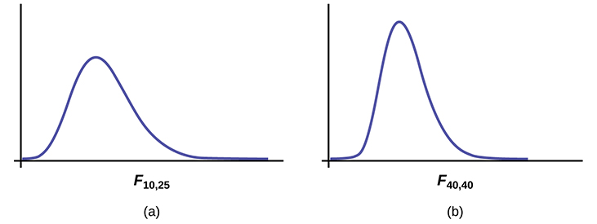
F Distribution
The curve is not symmetrical but skewed to the right.
There is a different curve for each set of degrees of freedom (dfs).
The F statistic is greater than or equal to zero.
As the degrees of freedom for the numerator and for the denominator get larger, the curve approximates the normal.

Slide 8
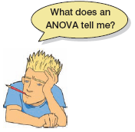
What Does ANOVA Tell us?
Null Hypothesis:
Like a t-test, ANOVA tests the null hypothesis that the means of the different groups are the same.
Alternate Hypothesis:
The means differ.
ANOVA is an Omnibus test
It test for an overall difference between groups.
It tells us that the group means are different.
It doesn’t tell us exactly which means differ.

Slide 9
One-way Between-Groups ANOVA
survey.dat (Julie Pallant)
Question
Is there a difference in optimism scores for young, middle-aged and old participants?
Need
One independent variable with three or more levels (age category) (agegp3)
One continuous variable (optimism scores) (totopt)
Non-parametric equivalent – Kruskal-Wallis Test

Slide 10
One-way Between-Groups ANOVA
One-way ANOVA will tell us whether there are significant differences in optimism scores (toptim) across the three groups (agegp3)
It will just do that
Tell us if there is a difference but not where the difference is
We need to conduct post-hoc tests (additional tests after the ANOVA) to find out where the differences lie
E.g. Is it between young and old, young and middleaged, middleaged and old?
Note: We consider toptim as we would any scale variable in advance to see if it can be considered normal, it can.

Slide 11
Preliminaries
Summary statistics for the variable of interest for each group
library(dplyr)
group_by(sdata, sdata$agegp3) %>%
summarise(
count = n(),
mean = mean(toptim, na.rm = TRUE),
sd = sd(toptim, na.rm = TRUE) )

Slide 12
Testing for homogeneity of variance in R
We need to check for homoscedasticity for the variable of interest across groups
In R we use Bartlett’s test
bartlett.test(sdata$toptim, sdata$agegp3)
Can be argued that the variances are homogeneous if the p-value > 0.05
Output:
Bartlett's K-squared = 1.4561, df = 2, p-value = 0.4828

Slide 13
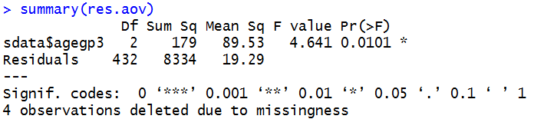
Basic ANOVA
# Compute the analysis of variance
# Compute the analysis of variance
res.aov <- aov(sdata$toptim ~ sdata$agegp3, data = sdata)
# Summary of the analysis
summary(res.aov)
There is a statistically significant difference

Slide 14
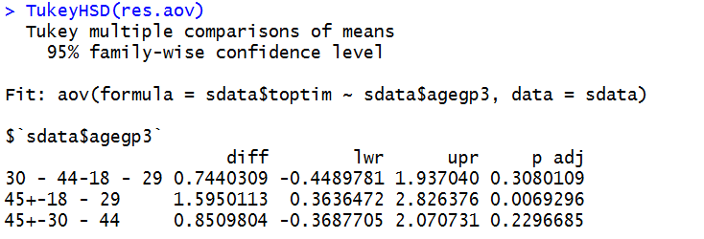
But where is the difference?
TukeyHSD(res.aov)
We can see the only significant difference is between our 45+ age group and our 18-29 age group and that the magnitude of difference is 1.6

Slide 15
Testing for homogeneity of variance
We need to know so we can conduct the correct post-hoc test
Homocedascticity – Tukey’s honestly significant difference (HSD) post hoc test
Otherwise use Games-Howell
In R need to specify in relevant post-hoc test function

Slide 16
In R – One Way ANOVA
#read the data into a dataframe
sdata <-read.table('survey.dat')
#install the library userfriendlyscience and load it
#it has a really nice one-way anova function that provides
#nice summary output
library(userfriendlyscience)
#run a one-way anova test using the correct post-hoc test Tukey in our case
one.way <- oneway(sdata$agegp3, y = sdata$toptim, posthoc = 'Tukey')
#printout a summary of the anova
one.way

Slide 17
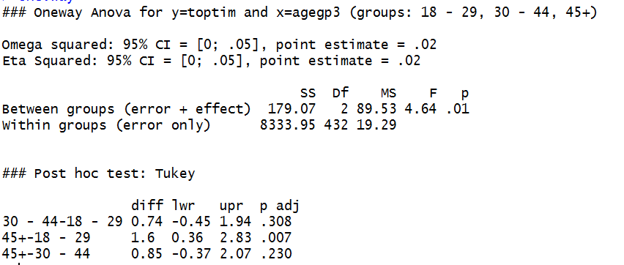
In R – One Way ANOVA
#output
We can see the only significant difference is between our 45+ age group and our 18-29 age group and that the magnitude of difference is 1.6

Slide 18
Calculating the effect size
eta squared = sum of squares between groups/total sum of squares (from our ANOVA output (rounded up))
=179/8334
=.02
Guidelines on effect size: 0.01 = small, 0.06 = moderate, 0.14 =large

Slide 19
Reporting the results
A one-way between-groups analysis of variance was conducted to explore the impact of age on levels of optimism, as measured by the Life orientation Test (LOT). Participants were divided into three groups according to their age (Group 1: 29 yrs or less; Group 2: 30 to 44 yrs; Group 3: 45yrs and above). There was a statistically significant difference at the p < .05 level in LOT scores for the three age groups: F(2, 432)=4.6, p=.01. Despite reaching statistical significance, the actual difference in mean scores between groups was quite small. The effect size, calculated using eta squared was .02. Post-hoc comparisons using the Tukey HSD test indicated that the mean score for Group 1 (M=21.36, SD=4.55) was statistically different to Group 3 (M=22.96, SD=4.49). Group 2 (M=22.10, SD=4.15) did not differ significantly from either Group 1 or 3.

Slide 20
What is this Bonferroni Correction?
When you conduct multiple analyses between groups on the same dependent variable you are inflating the chance of a Type I error
Incorrectly rejecting the null hypothesis
Bonferroni corrects/adjusts the p value by dividing the original α-value by the number of analyses on the dependent variable.

Slide 21
Beware! Multiple Comparison Problem
When reading a study, you can only account for multiple comparisons when you know about all the comparisons made by the investigators.
If they report only “significant” differences, without reporting the total number of comparisons, it is not possible to properly evaluate the results.
Ideally, all analyses should be planned before collecting data, and all should be reported.

Slide 22
Types of ANOVAs
Type | 2-way ANOVA for independent groups | repeated measures ANOVA | mixed ANOVA
Participants
 | Condition I | Condition II
Task I | Participant group A | Participant group B
Task II | Participant group C | Participant group D
 | Condition I | Condition II
Task I | Participant group A | Participant group A
Task II | Participant group A | Participant group A
 | Condition I | Condition II
Task I | Participant group A | Participant group B
Task II | Participant group A | Participant group B
Between-subject design
Within-subject design
both
NOTE: You may have more than 2 levels in each condition/ task
Notes:
The reasons for choosing one over another relate to feasibility and ease of recruiting (difficulties matching), wanting to investigate change in performance over time (developmental trajectories/ recovery over time) and others.
NOTE: You may have more than 2 levels in each condition/ task (the above are 2x2 ANOVAs)
So you could compare across 4 different ages and compare action naming vs action reading vs object naming vs object reading (this would be a 4X4 ANOVA)
There are also one-way ANOVAS which only test one factor over various levels (eg, naming activation in different ages)

Slide 23
Kruskal–Wallis test – Non Parametric
The Kruskal–Wallis test (Kruskal & Wallis, 1952;) is the non-parametric counterpart of the one-way independent ANOVA (analysis of variance).
The theory is very similar to that of the Mann–Whitney (and Wilcoxon rank-sum) test:
It is based on ranked data.
The sum of ranks for each group is denoted by Ri (where i is used to denote the particular group).

Slide 24

Kruskal-Wallis test Theory
Once the sum of ranks has been calculated for each group.
The test statistic, H, is calculated as:
R_{i} is the sum of ranks for each group.
N is the total sample size.
n_{i} is the sample size of a particular group.

Slide 25
Example
Open dataset youthcohort.dat
Taken from Quantitative Data Analysis in Education, Paul Connolly
Dataset Descriptor: http://cw.routledge.com/textbooks/9780415372985/pdfs/youthcohort.pdf
Question:
“Are there any differences between pupils of different ethnicity in England and Wales in relation to the grades they achieved in GCSE Maths?”
H₀: There is no difference
H_{A}: There is a difference
Variables
‘ethsfr’ ethnicity (nominal)
1 White 2 Black 3 Indian 4 Pakistani 5 Bangladeshi 6 Other Asian (inc Chinese) 7 Other ethnic group (inc mixed) 8 Not answered 9 Should be empty
‘gradmath’ grade achieved in maths (ordinal)
-9 Didn’t take 1 A* 2 A 3 B 4 C 5 D 6 E 7 F 8 G 9 Fail

Slide 26
Provisional Analysis – Statistics for gradmath grouped by ethnicity
In R:
library(psych)
describeBy(as.numeric(ydata$gradmath),factor(ydata$ethsfr) )
Why as.numeric and factor? describeBy requires first argument to be a vector (sequence of datatypes, here we want to use the numeric values not the grade descriptors) and second to be a factor (set of integer values with associated descriptors).

Slide 27
In R
ydata=read.table("youthcohort.dat")
Stats::kruskal.test(gradmath~ethsfr,data=ydata)
Output:
Kruskal-Wallis rank sum test data: gradmath by ethsfr Kruskal-Wallis chi-squared = 239.96, df = 6, p-value < 2.2e-16

Slide 28
In R
Post hoc test
We need the as.numeric to make sure our gradmath variable is treated as a numeric variable and we are using the numerical categories for ethsfr so we use the factors
#Need library FSA to run the post-hoc tests
library(FSA)
tmp<-dunnTest(x=as.numeric(ydata$gradmath), g=factor(ydata$ethsfr), method="bonferroni")
print(tmp, dunn.test.results = TRUE)

Slide 29
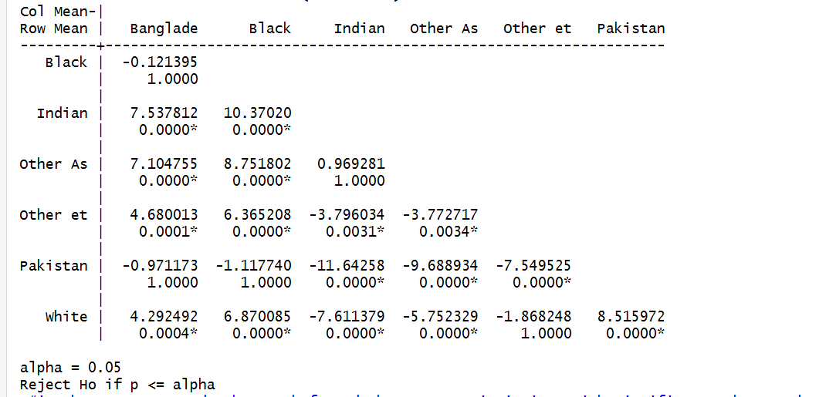
In R
X=gradmath, g=ethsfr
The test statistic is Z with significance is show underneath.

Slide 30
Friedman’s ANOVA
Non-parametric test for differences between several related groups
Used for testing differences between conditions when:
There are more than two conditions
The same participants have been used in all conditions (each case contributes several scores to the data).
If you have violated some assumption of parametric tests then this test can be a useful way around the problem.

Slide 31
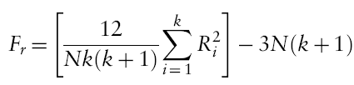
Theory of Friedman’s ANOVA
The theory for Friedman’s ANOVA is much the same as the other tests: it is based on ranked data.
Once the sum of ranks has been calculated for each group, the test statistic, F_{r}, is calculated as:

Slide 32
Example
Does the ‘andikins’ diet work?
Dataset diet.dat (Andy Field)
Variables
Outcome: weight (Kg)
Time since beginning the diet
Baseline (start)
1 Month
2 Months
Participants
10 people

Slide 33
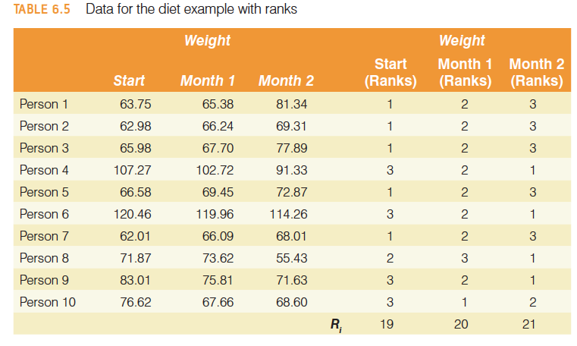

Slide 34
In R
#read in the data
diet <- read.table(“diet.dat”)
#treat our data as a matrix
Responses <- na.omit(with(diet, cbind(month1, month2, start)))
cat("\nMedians:\n")#display the heading Medians
#print out the medians of each of our variables
print(apply(Responses, 2, median))
#conduct the friedman test
friedman.test(Responses)
Output:
month1 month2 start
68.575 72.250 69.225
Friedman rank sum test data: Responses
Friedman chi-squared = 0.2, df = 2, p-value = 0.9048

Slide 35
Writing and interpreting the results
For Friedman’s ANOVA we need only report the test statistic (χ²), its degrees of freedom and its significance:
The weight of participants did not significantly change over the two months of the diet, χ²(2) = 0.20, p = .91.

Slide 36
Comparing Nominal Values

Slide 37
Comparing Nominal Variables
When two variables are independent, there is no relationship between them.
=> For all cases, the classification of a case into a particular category of one variable (the group variable) has no effect on the probability that the case will fall into any particular category of the second variable (the test variable).

Slide 38
Comparing Nominal Variables
Analyzing categorical variables
The mean of a categorical variable is meaningless
The numeric values you attach to different categories are arbitrary
The mean of those numeric values will depend on how many members each category has.
Therefore, we analyze frequencies.

Slide 39
Comparing Nominal Variables
Using the bullying.dat dataset (Paul Connolly)
Dataset Descriptor: http://cw.routledge.com/textbooks/9780415372985/pdfs/bullying.pdf
Contains the results of national school level survey, subset of this survey which deals with bullying.
Question:
“Is there a difference between boys and girls in terms of whether they have been bullied at school?”
H₀: There is no difference
H_{A}: There is a difference
Variables:
‘rsex’ {1-Male, 2-Female, 99-not answered};
‘ubullsch’ – Q26. Have you yourself ever been bullied in school? {1- Yes, 2 –No, 99-not answered}

Slide 40
Chi-square Test
We are comparing observed values to expected values according to a specific hypothesis (null hypothesis)
The null hypothesis for this test states that the proportions (the distribution across categories) are the same for all of the populations
Views the data as two (or more) separate samples representing the different populations being compared
The same variable is measured for each sample by classifying individual subjects into categories of the variable.
The data are presented in a matrix with the different samples defining the rows and the categories of the variable defining the columns.
The data, called observed frequencies, simply show how many individuals from the sample are in each cell of the matrix.

Slide 41
Chi Square Test for Independence
We are comparing observed values to expected values according to a specific hypothesis (null hypothesis)
The null hypothesis for this test states that the proportions (the distribution across categories) are the same for all of the populations
The null hypothesis is used to construct an idealized sample distribution of expected frequencies that describes how the sample would look if the data were in perfect agreement with the null hypothesis

Slide 42
Chi-Square Test for Independence
A chi-square statistic is computed to measure the amount of discrepancy between the ideal sample (expected frequencies from H₀) and the actual sample data (the observed frequencies).
Output is a cross tabulation table

Slide 43
In R
#import the library gmodels
library(gmodels)
#Read in the data
bully<-read.table("bullying.dat")
#Use the Crosstable function
#CrossTable(predictor, outcome, fisher = TRUE, chisq = TRUE, expected = TRUE)
gmodels::CrossTable(bully$rsex, bully$ubullsch, fisher = TRUE, chisq = TRUE, expected = TRUE, sresid = TRUE, format = "SPSS")

Slide 44
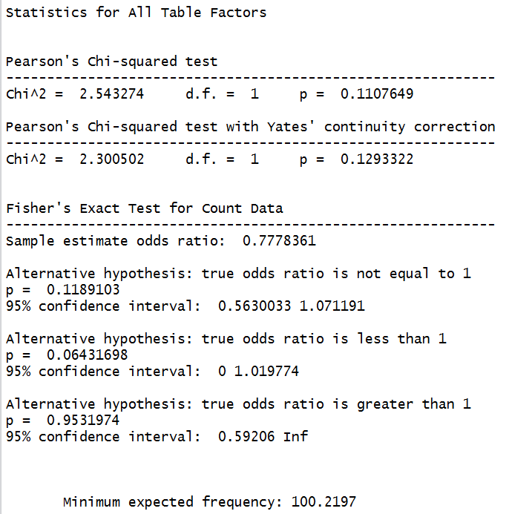
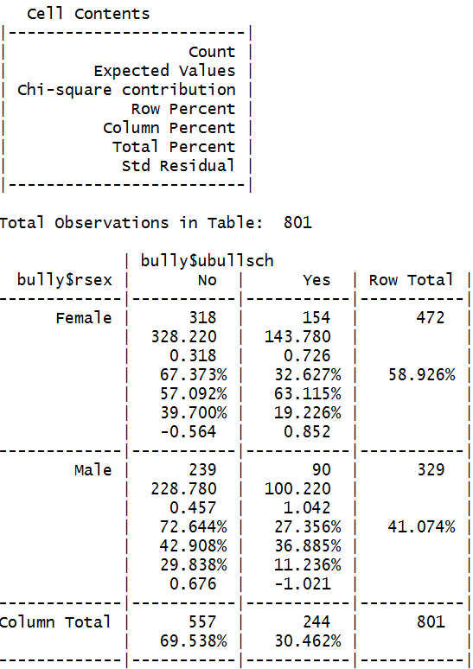
If we are looking at 2x 2 table we look at Yates continuity correction
Need to check this – assumption is that lowest expected frequency is 5 or more. If not then this test is not appropriate and should use Fisher’s Exact Probability Test.
Make sure your %s add up to 100.

Slide 45
Yate’s Continuity Correction
Again this is to prevent use making a Type I error
When we are doing a Chi-square test we are assuming that the probability distribution of the binomial frequencies observed approximate the Chi-square distribution
This is not quite correct
Yate’s correction adjusts Pearson’s Chi-square by subtracting 0.5 from each of the differences between the observed values and the expected values, which will reduce the Chi-square statistic and its associated p-value
Particularly important for small data (larger datasets this can be overcome)
May tend to overcorrect – make sure you reflect your research area’s perspective (some would say Yates is unnecessary even for small data).

Slide 46
In R – more simplistic
#Create your contingency table
mytable<-xtabs(~ubullsch+rsex, data=bully)
ctest<-chisq.test(mytable, correct=TRUE)#chi square test
#correct=TRUE to get Yates correction needed for 2x2 table
ctest#will give you the details of the test statistic and p-value
ctest$expected#expected frequencies
ctest$observed#observed frequencies
ctest$p.value
OUTPUT:
X-squared = 2.3005, df = 1, p-value = 0.1293

Slide 47
Chi Square Statistic
Measures the amount of discrepancy between the ideal sample (expected frequencies from H₀) and the actual sample data (the observed frequencies = f_{o}).
A large discrepancy results in a large value for chi-square which indicates that the data do not fit the null hypothesis and the hypothesis does not hold.
We compare our test statistic to the Chi Square distribution (in the form of a table) and we can get the probability that any deviation in the observed from the expected is due to chance only
For one degree of freedom
The critical value associated with p = 0.05 for Chi Square is 3.84
The critical value associated with p =0.01 it is 6.64
Chi-square values higher than this critical value are associated with a statistically low probability that H₀ holds.

Slide 48
Chi-Square Test for Independence
Reporting the findings
A Chi-Square test for independence (with Yates’ Continuity Correction) indicated no significant association between gender and reported experience of bullying, χ²(1,n=801)=2.30,p=.13, phi=-.056).

Slide 49
Repeated Measures Categorical Variables
Use McNemar’s test
Matched Samples or repeated measures (pre-test/post-test)
Two variables one recorded at Time 1 and one recorded at Time 2 (after an intervention)
Use for categorical variables with two response options
For 3 or more use Cochran’s Q-test
In R: mcnemar.test

Slide 50
Repeated Measures Categorical Variables
You can try this by using one of Pallant’s Dataset
experiment.dat
Fields Time1 Clinical Depression, Time 2 Clinical Depression
You should get a conclusion that indicates there is no significant change in those diagnosed as clinically depressed after the program of treatment

Slide 51
Back to Hypothesis Testing

Slide 52
Type I Errors
Occur when the sample data appear to show an effect/difference when, in fact, there is none in the population.
In this case the researcher will reject the null hypothesis and falsely conclude that there is an effect/difference.
Type I errors are caused by unusual, unrepresentative samples.
Just by chance the researcher selects an extreme sample with the result that the sample falls in the critical region even though there is no effect.
The hypothesis test is structured so that Type I errors are very unlikely
Specifically, the probability of a Type I error is equal to the alpha level.

Slide 53
Type II Errors
Occurs when the sample does not appear to have an effect/difference when in fact this exists in the population.
In this case, the researcher will fail to reject the null hypothesis.
Type II errors are commonly the result of a very small effects/differences (not large enough to show up in the research study).

Slide 54
Power of a Hypothesis Test
The power β of a hypothesis test is defined is the probability that the test will reject the null hypothesis when there is no effect.
The power of a test depends on a variety of factors including the size of the effect and the size of the sample.

Slide 55
Power analysis
An important aspect of experimental design.
Allows us to determine the sample size required to detect an effect of a given size with a given degree of confidence.
Also allows us to determine the probability of detecting an effect of a given size with a given level of confidence, under sample size constraints.
If the probability is unacceptably low, we would be wise to alter or abandon the experiment.

Slide 56
Power Analysis
sample size
effect size
significance level
P(Type I error) = probability of finding an effect that is not there
power
P(Type II error) = probability of finding an effect that is there
Given any three, we can determine the fourth.

Slide 57
Power Analysis
The pwr package implements power analysis as outlined by Cohen
Function | power calculations for
pwr.2p.test | two proportions (equal n)
pwr.2p2n.test | two proportions (unequal n)
pwr.anova.test | balanced one way ANOVA
pwr.chisq.test | chi-square test
pwr.f2.test | general linear model
pwr.p.test | proportion (one sample)
pwr.r.test | correlation
pwr.t.test | t-tests (one sample, 2 sample, paired)
pwr.t2n.test | t-test (two samples with unequal n)

Slide 58
Power Analysis
T-test
pwr.t.test(n = , d = , sig.level = , power = , type = c("two.sample", "one.sample", "paired"))
where n is the sample size
d is the effect size,
and type indicates a two-sample t-test, one-sample t-test or paired t-test. If you have unequal sample sizes, use
E.g. What size sample is needed to detect an effect size of 0.8 at the significance level 0.01 with a power of 0.8
pwr.t.test(d=0.8,sig.level=.01,power=0.8, alternative="two.sided")

Slide 59
Power Analysis
For a one-way analysis of variance use
pwr.anova.test(k = , n = , f = , sig.level = , power = )
where k is the number of groups and n is the common sample size in each group.
For a one-way ANOVA effect size is measured by f where Cohen suggests that f values of 0.1, 0.25, and 0.4 represent small, medium, and large effect sizes respectively.

Slide 60
Online Calculators
A range of online calculators are available at
http://statpages.info/#Power
You can also use Gpower
A downloadable application - http://www.gpower.hhu.de/

Slide 61
How can I increase Power?
Increase Alpha level
Changing alpha from 0.05 to 0.10 will increase your power (better chance of finding significant results)
Downsides to increasing your alpha level?
This will increase the chance of Type I error
This is rarely acceptable in practice
Only really an option when working in a new area:
Researchers are unsure of how to measure a new variable
Researchers are unaware of confounders to control for

Slide 62
How can I increase Power?
Increase N
Sample size is directly used when calculating p-values
Including more subjects will increase your chance of finding statistically significant results
Downsides to increasing sample size?
More subjects means more time/money
More subjects is ALWAYS a better option if possible

Slide 63
How can I increase Power?
Use fewer groups/variables (simpler designs)
Related to sample size but different
‘Use fewer groups’ NOT ‘Use less subjects’
↑ groups negatively effects your degrees of freedom
Remember, df is calculated with # groups and # subjects
Lots of variables, groups and interactions make it more difficult to find statistically significant differences
The purpose of the Family-wise error rate is to make it harder to find significant results!
Downsides to fewer groups/variables?
Sometimes you NEED to make several comparisons and test for interactions - unavoidable

Slide 64
How can I increase Power?
Measure variables more accurately
If variables are poorly measured (sloppy work, broken equipment, outdated equipment, etc…) this increases measurement error
More measurement error decreases confidence in the result
More of an internal validity problem than statistical problem
Downsides to measuring more accurately?
None – if you can afford the best tools

Slide 65
How can I increase Power?
Decrease subject variability
Subjects will have various characteristics that may also be correlated with your variables
Gender,race/ethnicity, age, etc…
These variables can confound your results, making it harder to find statistically significant results
When planning your sample (to enhance power), select subjects that are very similar to each other
This is a reason why repeated measures tests and paired samples are more likely to have statistically significant results
Downside to decreasing subject variability?
Will decrease your external validity – generalizability
If you only test women, your results do not apply to men

Slide 66
How can I increase Power?
Increase magnitude of the mean difference
If your groups are not different enough, make them more different
Compare a ‘very’ high group to a ‘very’ low group
Sampling at the extremes, getting rid of the middle group
Downsides to using the extremes?
Similar to decreasing subject variability, this will decrease your external validity

Slide 67
The Catch-22 of Power and P-values
The larger your sample, the more likely you’ll find statistically significant results
Sometimes miniscule differences between groups or tiny correlations are ‘significant’
This becomes relevant once sample size grows to 100~150 subjects per group
Once you approach 1000 subjects, it’s hard not to find p < 0.05
Example from most highly cited paper in Psych, 2004…

Slide 68
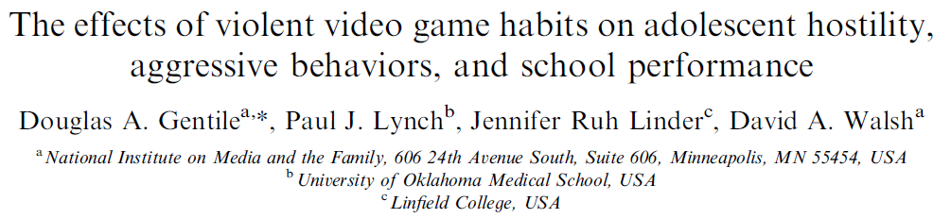
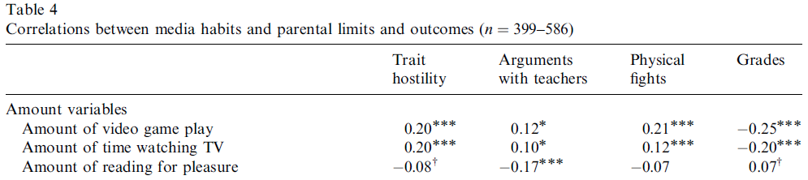
This paper was the first to find a link between playing video games/TV and aggression in children
Every correlation in this table except 1 has p < 0.05
What does a correlation of 0.10 looks like?

Slide 69
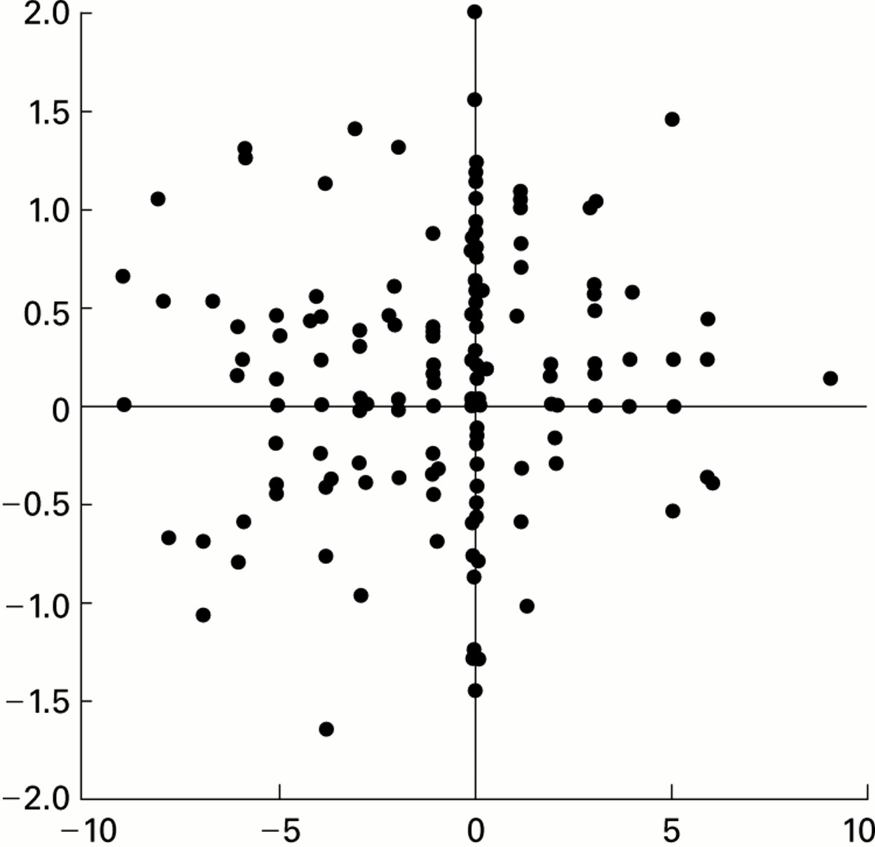
r = 0.10
Do you see a relationship between these two variables?

Slide 70
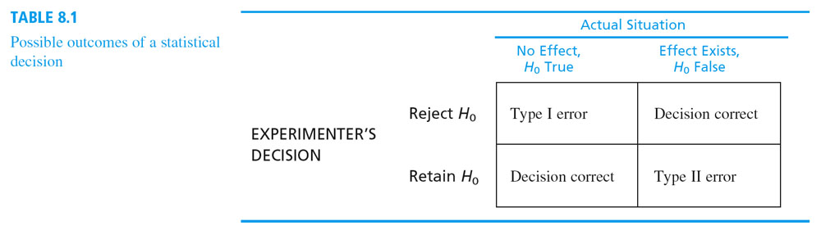

Slide 71
Measuring Effect Size
A hypothesis test evaluates the statistical significance of the results from a research study.
The hypothesis test is influenced not only by the size of the effect/difference but also by the size of the sample.
Thus, even a very small effect/difference can be significant if it is observed in a very large sample.
Finding a statistically significant result does not necessarily mean a large effect
It is recommended that the hypothesis test be accompanied by a measure of the effect size.
Cohen’s measures of effect size are used as standard.

Slide 72
Effect Size
To get an idea of how ‘important’ a difference or association is, we can use Effect Size
There are over 40 different types of effect size
Depends on statistical test used
Effect size is like a ‘descriptive’ statistic that tells you about the magnitude of the association or group difference
Not impacted by statistical significance
Effect size can stay the same even if p-value changes
Present the two together when possible

Slide 73
Another example
If we sample a group of 100 students and find their average IQ is 103.
The population mean for IQ is 100, SD = 15.
We run a one-sample t-test and find it to be statistically significant (p < 0.05)
However, effect size is…
0.2, or Small Effect
Interpretation: While this difference is likely not due to random sampling error – it’s not very important either

